Slide 1
Detecting Visual Relationships with Deep Relational Networks
Bo Dai et.al CVPR 2017 ORAL

Slide 2
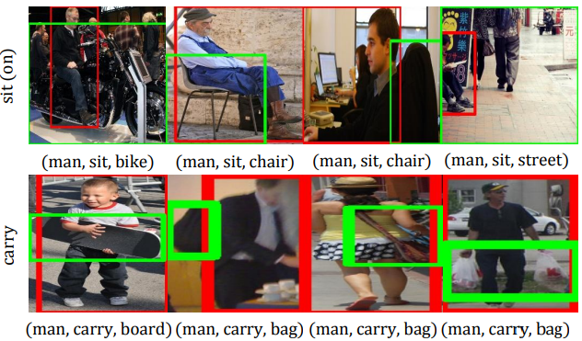
At a glance
[s(ubject), r(elationship), o(bject)]

Slide 3
Pipeline
Object detection
Given an image, use an object detector to locate a set of candidate objects.
Pair filtering
With n detected objects, we can form n(n − 1) pairs. Introduce a low-cost neural network to filter out such pairs. This filter takes into account both the spatial configurations (e.g. objects too far away are unlikely to be related) and object categories (e.g. certain objects are unlikely to form a meaningful relationship).
Joint recognition
Each retained pair of objects will be fed to the joint recognition module. Taking into account multiple factors and their relations, this module will produce a triplet [s, r, o] as the output.

Slide 4
Joint recognition
A deep relational network is used for Joint recognition. Before that, let’s see what information that network used.
Appearance: Appearance feature of the two object bounding boxes, also a bounding box that encompasses both objects with a small margin(context of relationship).
Spatial Configurations: relative positions and relative sizes.
Statistical Relations: In dataset of Visual Genome, for [s, r, o], the entropy of p(r) is 2.88, while that of the conditional distribution p(r|s, o) is 1.21. This is a nice example on how to utilize our knowledge learned in class.

Slide 5
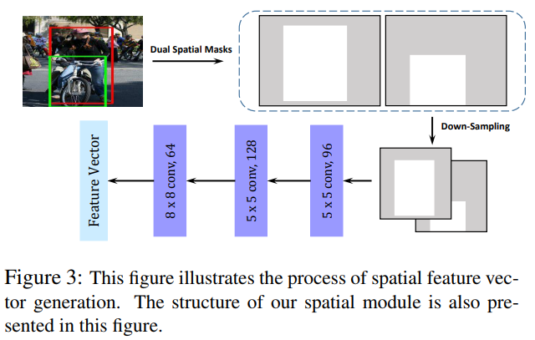
Spatial Configurations
The masks are downsampled to the size 32 × 32, which we found empirically is a good balance between fidelity and cost.
The dual spatial masks for each candidate pair will be compressed into a 64-dimensional vector via three convolutional layers.
My: It’s interesting simple mask would be able to result a feature for relationship.

Slide 6
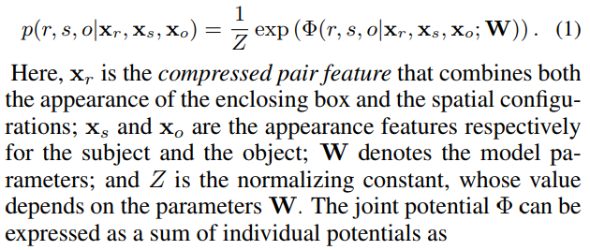
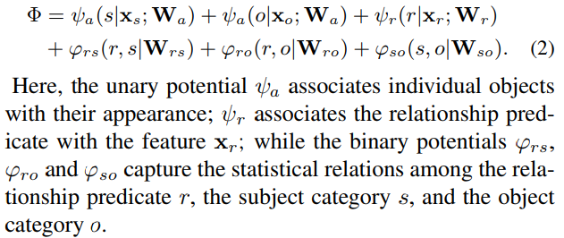
Deep relational network
1. Model the problem as (1)
Term potential means unnormalized probability.
2. Split this conditional probability as (2)
For the + in (2), I think it’s exp()*exp() in (1), then * becomes + in(2)
Continuing

Slide 7




Deep relational network
Given s and o, some terms in (2) disappears, and (1) becomes (3)
Let and the same for W_ro. I think there is a little abusion of symbol, what the author wants is that the matrix W_rs acts as phi_rs, i.e, = f(r,s;W_rs). And let be a vector of the posterior probabilities for r. Then in vector form, (3) becomes (4)
(4) is the optima to the optimization problem (5)
Continuing

Slide 8
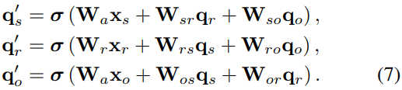
Deep relational network
Replace the (groundtruth) with inference, get (6):
Similar to 3~5, we can get all q on r,s and o.
Then we iteratively update these q, as (7):
(7) can also be viewed as a computing layer, then the iterative updating procedure can be unrolled into a network that comprises a sequence of such layers. Here you may have a question as me: in (7), we can have infinite times iterations, but with neural network, we can only have finite times iterations, is it good enough? Continuing

Slide 9
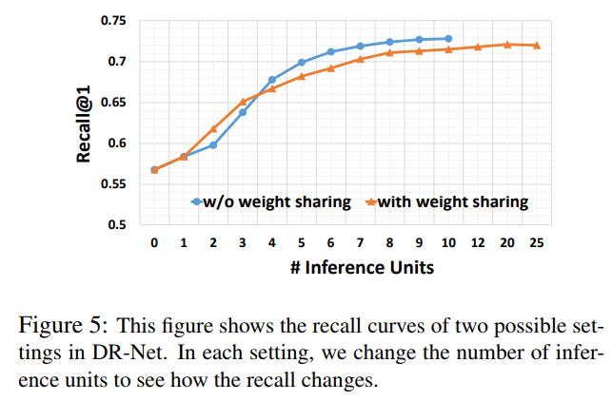
Deep relational network
For the question, the author tried different numbers on finite times iterations, as figure 5.
Continuing

Slide 10
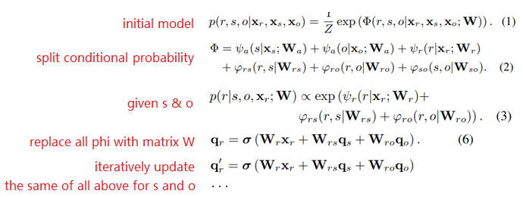
Deep relational network
Let’s briefly see the whole calculation process:
My view on why deep relational network works:
conditional random field(split r, s, o) ii. W model phi(easy to tackle)
iii. iteratively update iv. using a network to update(novelty)

Slide 11
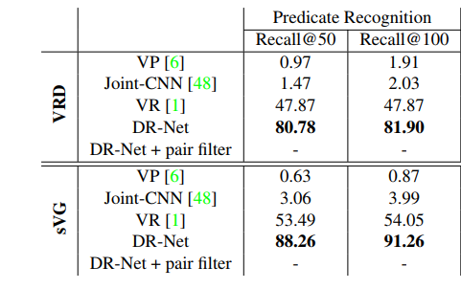
In practice
https://github.com/doubledaibo/drnet_cvpr2017 Code in Python, with Caffe.
The reason of using recall instead of precision is that the annotations are incomplete, where some true relationships might be missing.

